Slide 1
SKKU Parking Guide
Real-Time Parking App
Weekly Progress
Team I-dle Kim Seheon Kim Hyeongjin Noh Hayeon Park Inchan

Slide 2
Contents
Project Overview
Weekly Progress
Front-end / Data Preprocessing / AI Model
Future Plan
Next steps for project advancement
Team Contributions

Slide 3
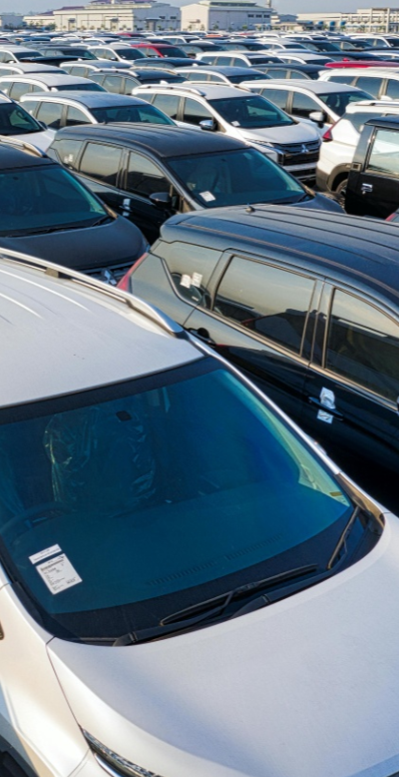
Project Overview
#1
Parking management system uses
to detect car park vacancies
Technical Background
1. YOLOv5:
real-time analysis of parking spaces and vehicle sizes.
2. Camera and AI integration system:
Data collected by cameras is processed by AI model, stored in a database, and linked to a mobile app.

Slide 4
Weekly Progress
#2
~Week5 | Week6 | Week7~
proposal...
Data Preprocessing
UI/UX Design, App Front-end
Model Train

Slide 5
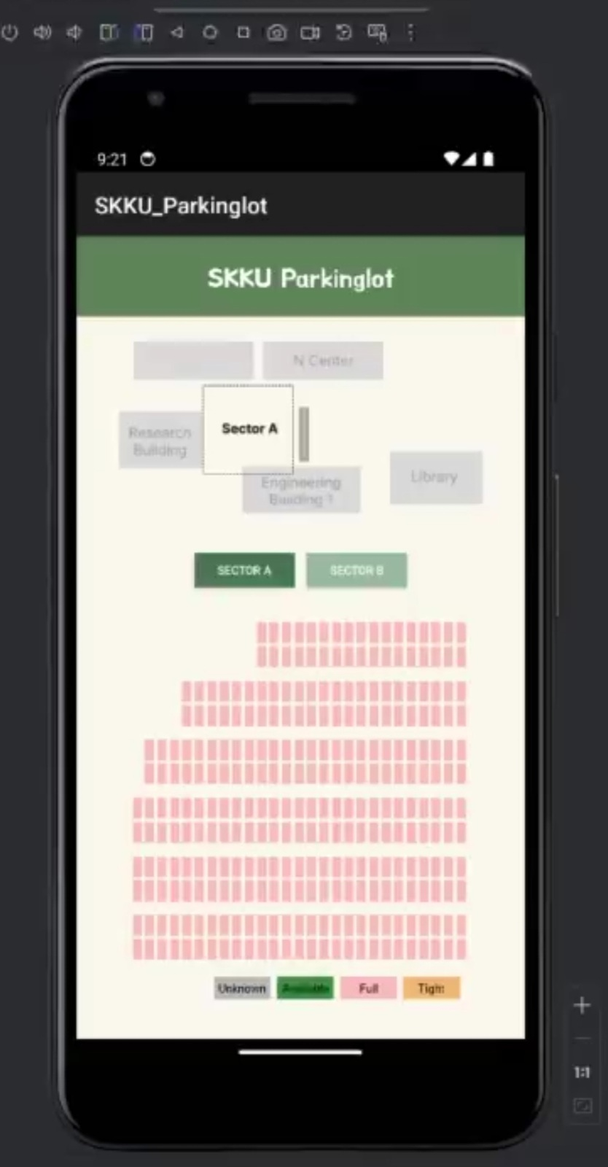
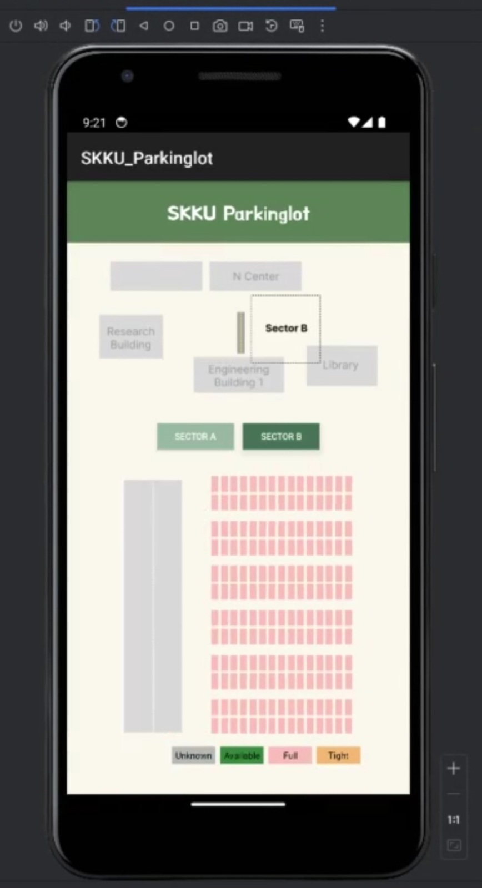
Front-end
#2.1
Completed the basic configuration of the app based on the design.
Designed an intuitive UI to provide users with real-time parking space information.

Slide 6
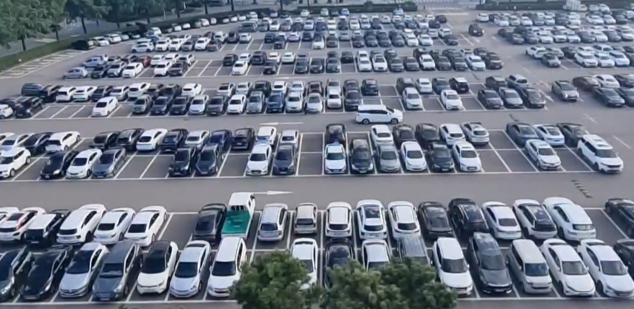

Data Preprocessing
#2.2
Labelling parking space coordinates
Collecting training data
Filming a video of SKKU parking lot for testing

Slide 7

AI Model
#2.3
01.
02.
03.
Data collecting coco dataset
Training the YOLOv5 model
Test with a screenshot of our parking lot

Slide 8
Future Plan
#3
App Back-end
Cloud-based database to store and synchronise car park data in real-time
Integrate Model with App
01.
02.
03.
04.
05.
Model Train
Model Evaluation
Testing & Revision
1. Need to train the model to recognize the size of car
2. Improve the model to achieve high accuracy even with video

Slide 9
Team Contributions
Kim Seheon
Kim Hyeongjin
Noh Hayeon
#4
Park Inchan
Team Leader
Front-end Development
Find
Parking Spot Coordinates and Label
Training and Testing AI Models (YOLOv5)
Create a Weekly Progress Presentation

Slide 10
Thank You

